Slide 1
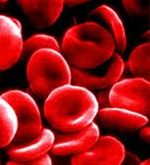
MT 14, The Blueprint of Life
Friday 01.11.13
TOPIC:
MY GOAL:
CHECK
THIS
OUT
I will… see DNA!
The only cells in the human body that do not contain DNA are red blood cells…
They have nuclei during early development, but extrude them as they mature…
Provides more space for hemoglobin (as does the shape) → more surface area = more hemoglobin = more oxygen!

Slide 2
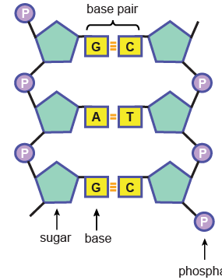
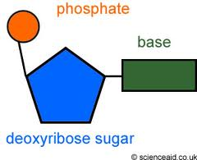
What is this Monomer Called? What does it make up? How many Monomers are in this molecule?
phosphate

Slide 3
What is the matching ½ of DNA
&
What do the 3 ‘letters’ mean??
ACA – ATT – CCC
TGT - TAA –GGG
A.A
A.A
A.A
Protein
Protein
Protein
Trait
Trait
Trait
Notes:
3

Slide 4
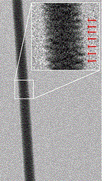
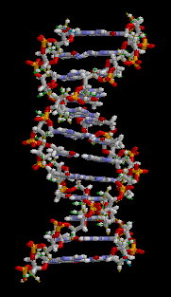
LAB
Extracting DNA From a Strawberry
Read Background!
Follow Procedure step-by-step! Reach each step FULLY BEFORE doing anything!
Lab Report – due Monday!
Title
Purpose
Data
Conclusion
Largest human Xsome - #1, is approximately 220 million base pairs long but only 50 trillionths of an inch in width.

Slide 5
Study this weekend
Read over your notes
Cover half of it up to quiz yourself
Read over the same section in your textbook
Read over the same section in your Interactive Reader
HOMEWORK
Be the change you wish to see in the world
Notes:
5
5

