Slide 1
Measurement Topic 15, Reproduction of Life
Mon 01.28.13
TOPIC:
MY GOAL:
GET
ON
TASK
I will review my MT 14 MAJORSum and set up my ISN with the new MT 15 packet and get a basic understanding of the 2 types of Cell Reproduction
If you did not take the MAJORSum on Friday, take out a sheet of paper, # from 1-20 → be prepared to go next door to take the test.
The rest will go over their results

Slide 2
Introduction to 2 Types of Reproduction
Set Up new Measurement Topic
Review MT 14 MAJORSum

Slide 3
How DNA uses RNA to tell Ribosomes to make Proteins
mRNA = TRANSCRIPTION = rewrites DNA’s blueprint/message = delivers it to ribosomes (describes which a.a. should be put together)
a.a. in cytoplasm – need help getting over to ribosomes → picked up by tRNA = TRANSLATION → translates mRNA’s message & organizes correct a.a.
TrAits!!!
A
T-
C-
A-
T-
T-
T
A
G
T
A
A
3. PROTEINS
DNA
U
C
A
U
U
C
A
U
1. mRNA
1. mRNA
aa
C
A
U
A
aa.
aa. aa.
2. tRNA

Slide 4
ISN page 132 Reflection
Measurement Topic 14, The Blueprint of Life
Write down at least 5 things you can think that you learned over the last 2 weeks – See if they are the same as mine….
DNA helps determine genetic traits
DNA is made up of nucleotides
DNA = A-T, C-G
RNA helps DNA make proteins
RNA = A-U, C-G
mRNA, tRNA
Proteins determine traits
Proteins are made in ribosomes
Proteins are made up amino acids

Slide 5
ATTACH New Packet Pages
Packet Title page TO ISN page 133
Packet page 2 TO ISN page 135
Packet page 3 TO ISN page 137
Packet page 4 TO ISN page 139
Packet page 6 TO ISN page 140

Slide 6
YOUR JOB = Complete ISN page 133
REPRODUCTION
Is the production of…
Offspring
There are two major types of reproduction…
Asexual
Which requires one…
Which requires two…
Parent
And produces offspring that are genetically…
A type of asexual reproduction is…
A type of sexual reproduction is…
Meiosis
That produces…
That produces…
____(#) cells
_____(#) cells
The purpose of Mitosis is to produce cells for…
The purpose of Meiosis is to produce…
The cells produced have the --- # of Xsomes
The cells produced have --- the # of Xsomes
The same

Slide 7
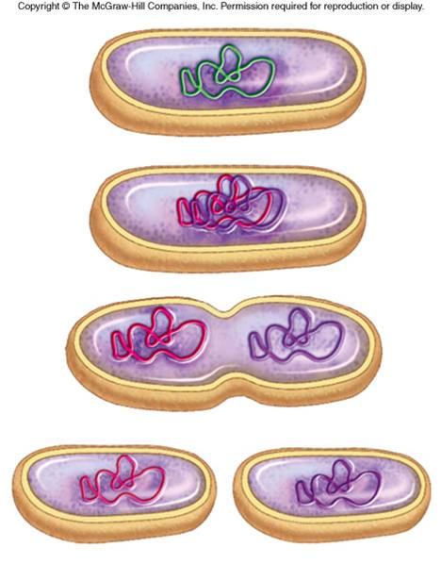
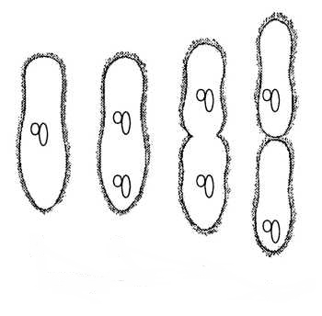
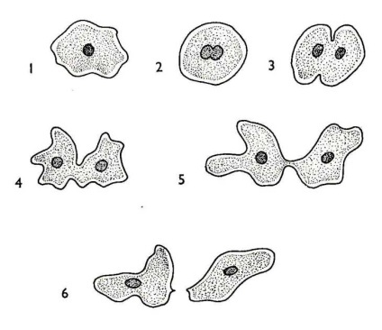
Asexual Reproduction!
BiNary Fission in Bacteria
Binary Fission In Paramecium
Up to 3 times/day
can divide every 20 minutes → single cell can produce a colony of 10⁷ to 10⁸ bacteria in about 12 hours (100 mill)
http://www.youtube.com/watch?v=_FBBnNhN_NM&feature=related&safety_mode=true&persist_safety_mode=1&safe=active
http://www.youtube.com/watch?v=vnlkvquWXS8&feature=related&safety_mode=true&persist_safety_mode=1&safe=active

Slide 8
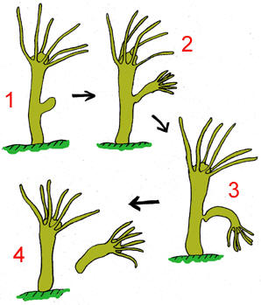
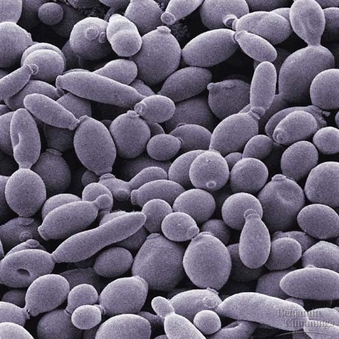
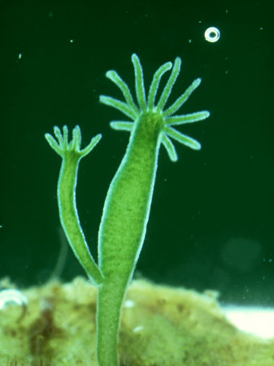
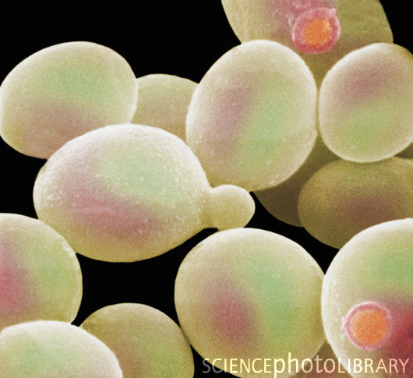
Asexual Reproduction!
Budding in Yeast
Budding in Hydra
http://www.youtube.com/watch?v=489CSop00sY&safety_mode=true&persist_safety_mode=1&safe=active
http://www.youtube.com/watch?v=iOvrq6ssy2Y&feature=related&safety_mode=true&persist_safety_mode=1&safe=active
http://www.youtube.com/watch?v=Kukv0AtIVdU&safety_mode=true&persist_safety_mode=1&safe=active

Slide 9
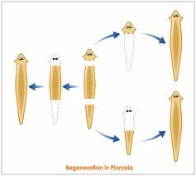
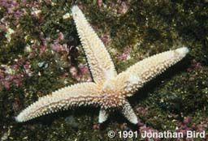
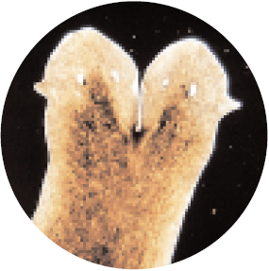
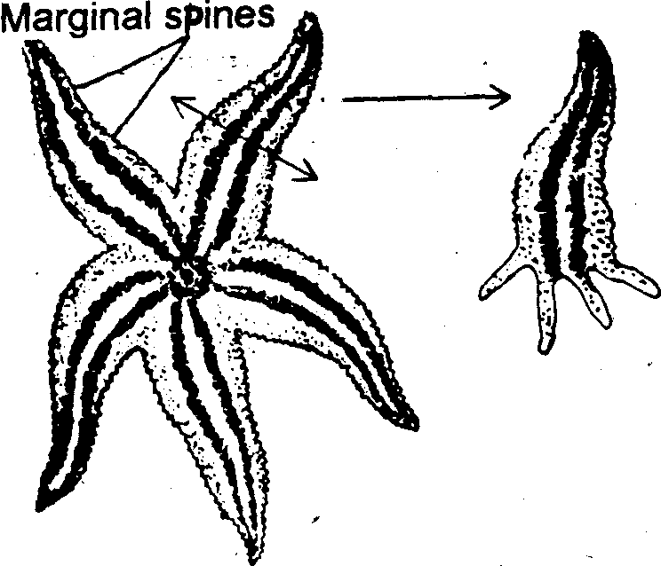
Asexual Reproduction!
Fragmentation is the unintentional cutting up of the body of an organism which each grows into different organism. (planaria, starfish)
Regeneration is the growing back of a lost part of the body of an organism. It is usually used as a method of defense. (lizard)
Fragmentation in Planaria
Regeneration in Starfish

Slide 10
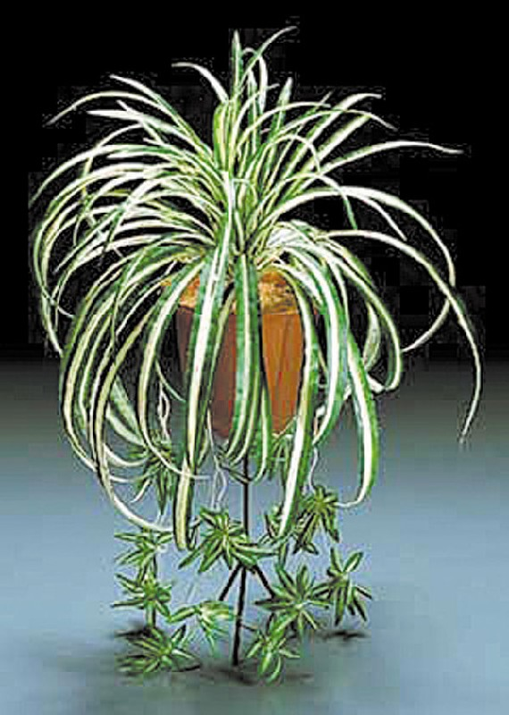
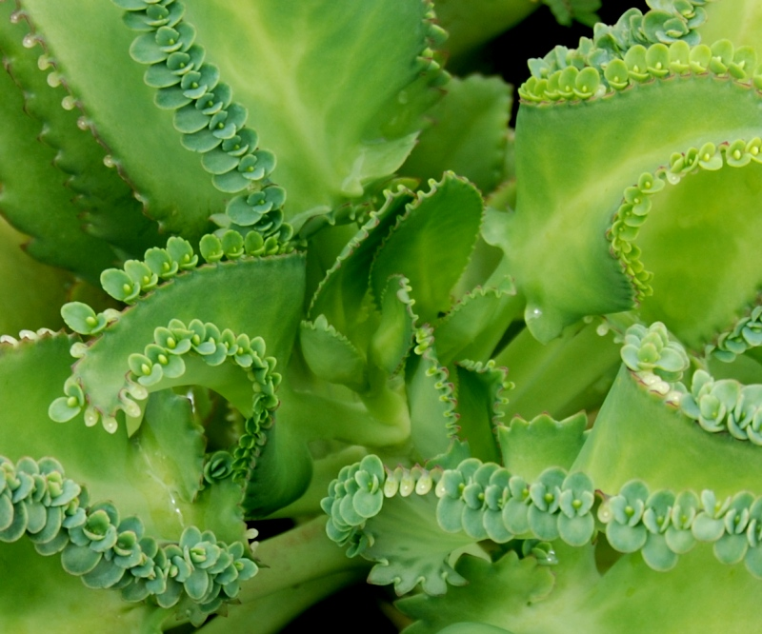
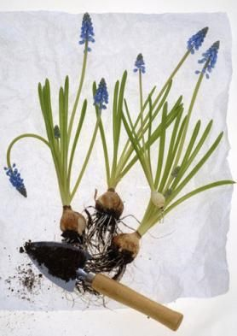
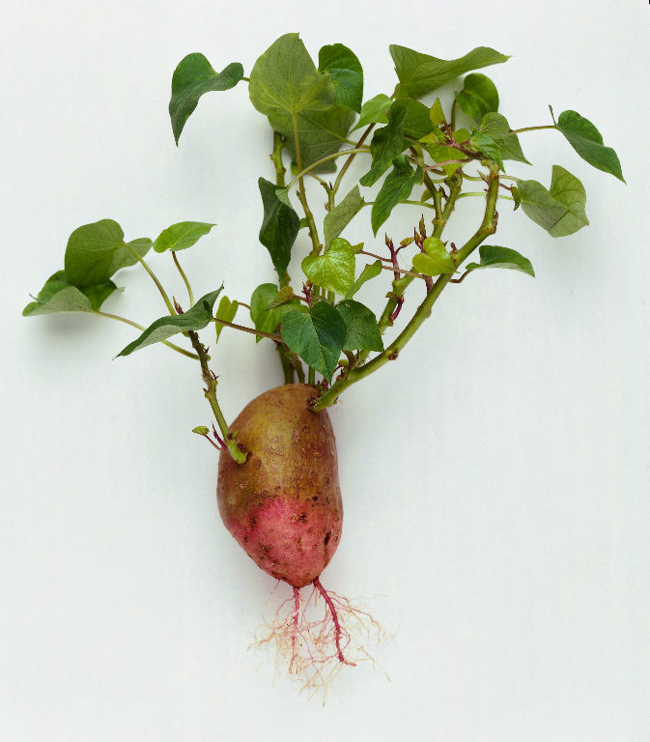
Asexual Reproduction in Plants!

Slide 11
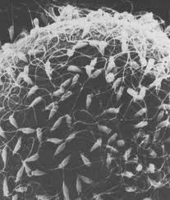
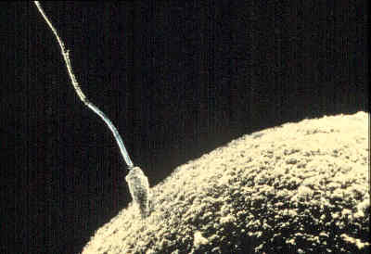
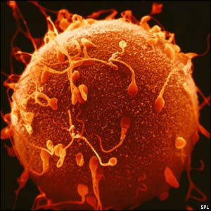
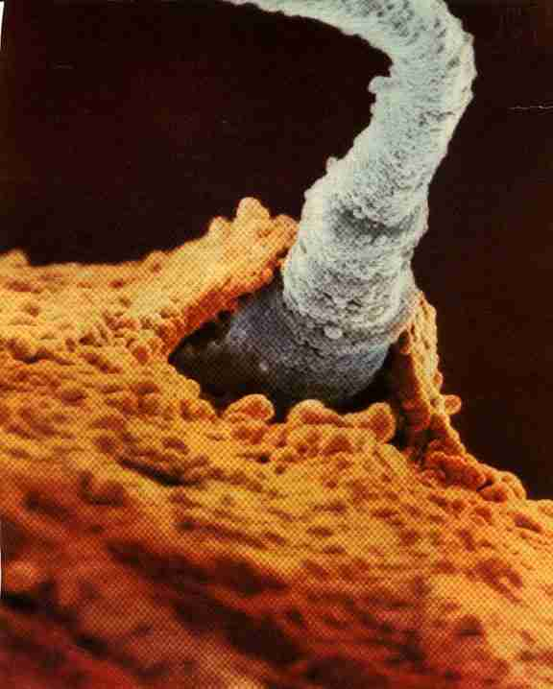
Sexual Reproduction!
SPERM + EGG = ZYGOTE
+
=
Joining… Fusion of GAMETES → Fertilization

Slide 12
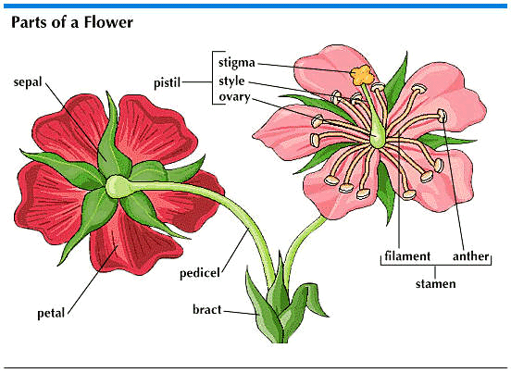
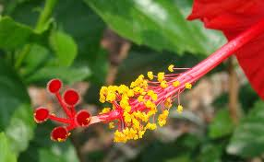
Sexual Reproduction in Plants!

Slide 13
Did we reach the Goal for the Day?
…to get a basic understanding of the two basic types of Cell Reproduction…
Did you reach that goal?
How do you know that you reached that goal?
What are you going to do if you did not reach that goal?
Notes:
13

Slide 14
Accept our connectedness to events.
It is not unknown forces that cause our problems.
We are the cause and the cure.
We create our own reality and we can change it.
HOMEWORK
Be the change you wish to see in the world
Notes:
14
14

