Slide 1
Textbook p.143
Thurs 12.31.13
Standard 7, Reproduction of Life
TOPIC:
MY GOAL:
DID YOU
KNOW?
I will identify the phases of The Cell Cycle including Mitosis
Q: When a cell divides itself, The Newly formed cells are called daughter cells . Why not son cells Or something else??
A: Because in terminology, the source is called 'mother'(mother plant, mother ship) & the descendants or new formations are called daughters. Because in animal life, a female or mother can give birth to offspring, & not a male or father. If a cell divides, the new cells can usually divide again, thus 'giving birth' in a certain sense, thus being referred to by a female term.

Slide 2
MITOSIS… Can you fill in the cells?
2 pair of single stranded Xsomes = 4 single strands
Replication… which means…
the single Xsomes change to double-stranded Xsomes
Cell divides
End up with 2 cells that are IDENTICAL to parent = same # of Xsomes (4 single strands) – only diff. is daughter cells are smaller

Slide 3
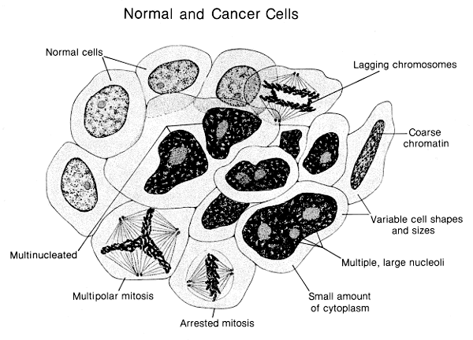
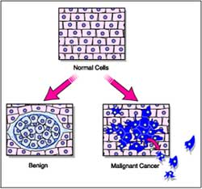
Normal Cells vs Cancer Cells

Slide 4
Mitosis Math Lab
TEXTBOOK page 143
READ the procedures
You will OMIT:
Drawing of stages in step 2
Step 3 – you will use the WHOLE micrograph NOT just a random area → the micrograph IS a random area

Slide 5
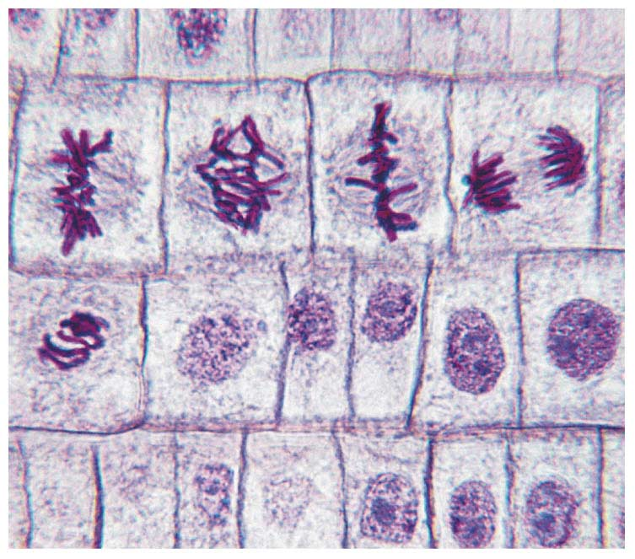
Follow procedure in book!
Mitosis mAth Lab
Look → Count TOTAL # of cells in MicroGraph → Record → Then Count # of cells in Each Phase of the Cell Cycle → Record → Figure % of Each Stage → Record → Graph % AT THIS TIME → Answer questions
To Figure %, you must have a Total 1st…
Total Cells = 16
Metaphase = 2 = 2/16
= 12.5%

Slide 6
Mitosis Math Lab
Look → Count TOTAL # of cells in MicroGraph → Record → Then Count # of cells in Each Phase of the Cell Cycle → Record → Figure % of Each Stage → Record → Graph % AT THIS TIME → Answer questions
Title: 1 pt
Purpose: The purpose of this lab is to…1 pt
Data: 6 pts
Data Table from book (Honors take 3 samples!)
Graph results of data table → title, X & Y axis labeled!
Conclusion: 4 pts
Write question → Underline answer
Name
Period

Slide 7
Read over all pages in your ISN tonight.
There is a MiniSummative tomorrow!
HOMEWORK
Be the change you wish to see in the world
Notes:
7
7

